Slide 1


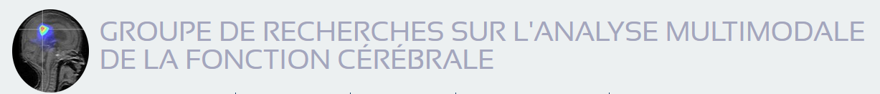
Functional brain imaging with optically-pumped-magnetometers Work progress – Saeed ZAHRAN
Friday 19/02/2021

Slide 2
Objectives
Provide first insights on the added value of Helium OPM compared to SQUIDs
Compare OPM to SQUIDs by using simulated data in a first step
in an adult headmodel
In a child headmodel
In a baby headmodel
In fœtus
Compare OPM to SQUID on real measurements (in Brussels)
Demonstrate the operability of the MEG Helium OPM 5 sensors system

Slide 3
Working hypotheses
The three measurement axes OPM can bring more information than SQUID, notably for radial sources (classically not recorded by MEG SQUID but recorded in EEG)
The decrease of the sensor-scalp distance (OPM are placed over the scalp) will improve the MEG signal

Slide 4
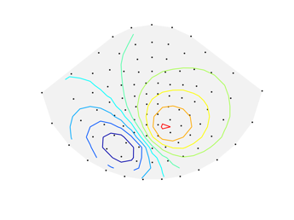
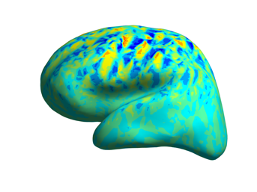
Theory
Magnetic field at the sensors is related to the amplitudes of the current dipoles as
Matrix is the lead-field matrix
Columns: source topographies
Rows: sensor lead fields (sensitivity patterns)
Notes:
The primary current distribution is typically discretized into a set of
current dipoles (Hämäläinen et al., 1993). The output of a sensor is
obtained by integrating the magnetic field due to primary-current
dipoles through the sensitive volume of the sensor; the sensitive
volume is discretized into a set of integration points
With these models, the magnetic-field amplitudes at the Nc sensors
b ∈Nc×1 are related to the Ns amplitudes of the current dipoles
j ∈Ns×1 by a linear mapping
where L ∈ Nc×Ns is the lead-field matrix. The ith column of the leadfield
matrix represents the magnetic field pattern of the ith unit source,
i.e., the topography of source (ti); the jth row represents the sensitivity
pattern of the jth sensor to the sources, i.e., the lead field of sensor (lj).
<numéro>

Slide 5
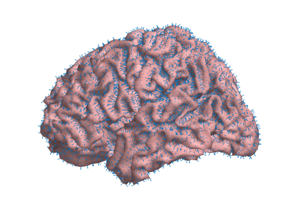
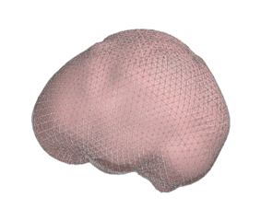
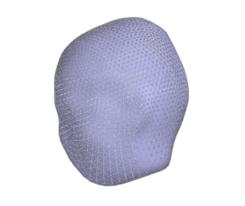
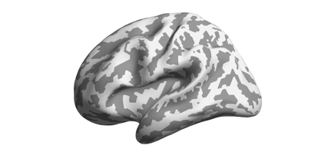
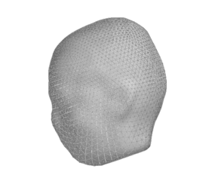
Methods
Uses Brainstorm software and MNE python codes
Anatomical models from MRIs
Primary current distribution
- 10 242 dipoles per hemisphere
Construction of the OPM arrays
Lead-field matrix computation by using OpenMEEG (Gramfort, 2010)
- Three-shell realistic model: brain, skull and scalp
- 5 120 triangles per surface
Notes:
We built forward models based on
magnetic resonance images of the head; we employed a three-compartment boundary element model and
distributed current dipoles evenly across the cortical mantle.
We simulate the performance of OPM arrays
of sensors that measure the normal and tangential components of the
neuromagnetic field. We compare the performance of such arrays to a
state-of-the-art SQUID-based 102-channel MEG array. In our simulations,
we use realistic geometries derived from magnetic resonance
images and calculate magnetic fields using the
boundary element method. We use well-established
metrics derived from forward models ,The metrics quantify signal power, information
capacity. Sensitivity to Source Orientation
First, we constructed the anatomical models
from the magnetic resonance images (MRIs), modeled the sensors and
sensor arrays, and then computed the lead-field matrices
Subsequently, we built the lead-field matrices for the computation of performance metrics.
Anatomical models
T1-weighted MRIs were obtained from healthy adult
using a 3-T scanner,
FreeSurfer software was used to segment the cortical mantles from individual MRIs
The
primary current distributions were assumed to lie on the cortical surfaces
and ,For each subject, we used the
watershed algorithm (Ségonne et al., 2004) implemented in FreeSurfer and
Brainstorm to segment the brain, skull and scalp
compartments. We triangulated and decimated these surfaces to obtain
threemeshes (2 562 vertices permesh) for the BEM
<numéro>

Slide 6
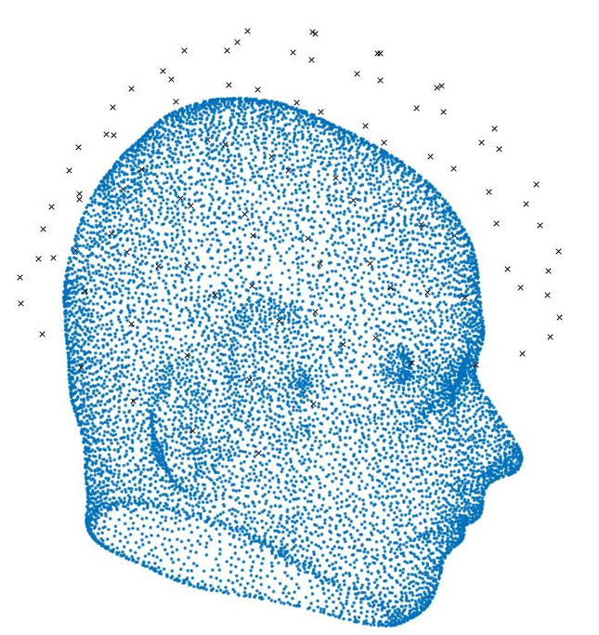
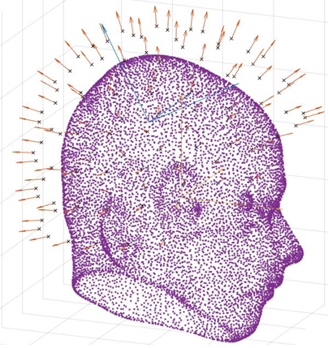
Constructing the OPM sensors model
Initial position of the SQUID helmet
Adjusted position of the SQUID helmet
Notes:
SQUIDs require a cryogenic environment, and liquid helium
(boiling point 4.2 K) is typically used for reaching sufficiently low
temperatures. The necessity of cryogenics imposes several problems:
First, cryogenics make MEG systems bulky. Second, the necessary
thermal isolation between the sensors and the subject sets a lower
limit, typically about 2 cm, on the distance from the sensors to the scalp
of the subject.
Last, a SQUID-based sensor array is not adjustable to
individual head size and shape, which further increases the average
distance between sensors and scalp.
The SQUID sensor arrays of the Elekta Neuromag® MEG system
(102 magnetometers;) were positioned around the subjects' head as in a real MEG
measurement. For each subject, the position was determined so that
the SQUID array covered the cortex uniformly and symmetrically along
the left–right axis. Thereafter, the sensor positions were verified to be
at least 2 cm (approximate thickness of the MEG dewar) from the scalp.
Each of these arrays measures the
amplitude of the magnetic field component normal
to the surface of the MEG helmet.
<numéro>

Slide 7
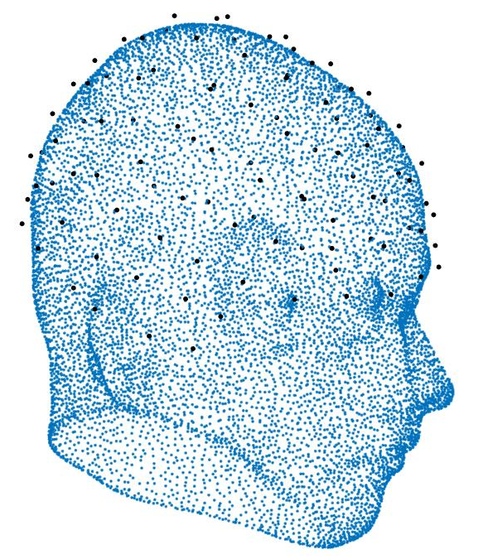
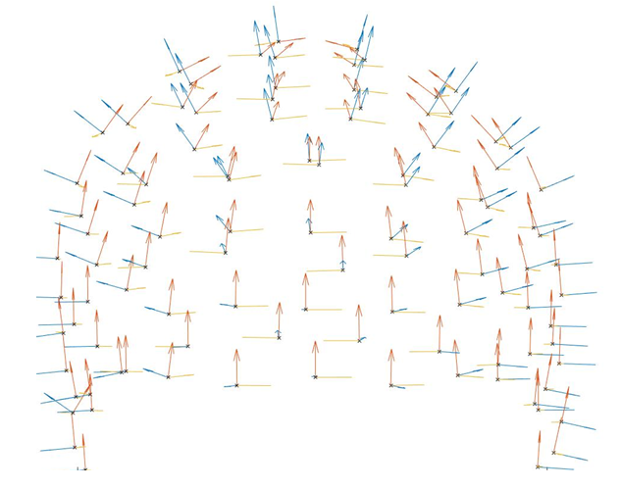
Constructing the OPM sensors model
OPM positions
OPM Orientations
Notes:
The OPM locations were derived from the SQUID
arrays by projecting the sensor locations to the scalp. The distance of
the closest face of the OPM sensor cube to scalp was set to 1 mm. For
these positions, we defined three different OPM arrays: one with 102
sensors measuring the normal component of the magnetic field with
respect to the local surface of the scalp (nOPM), other with 204 sensors
measuring the two orthogonal tangential components (tOPM)
future
and a
combination of the aforementioned arrays, with 306 sensors measuring
all field components (aOPM).
The sensitivies of the OPMs should thus allow the measurement of
weak neuromagnetic fields while their dimensions enable multichannel
whole-head-covering measurements. OPMs could also be placed within
few millimetres from scalp, permitting EEG-cap-like MEG arrays.
<numéro>

Slide 8
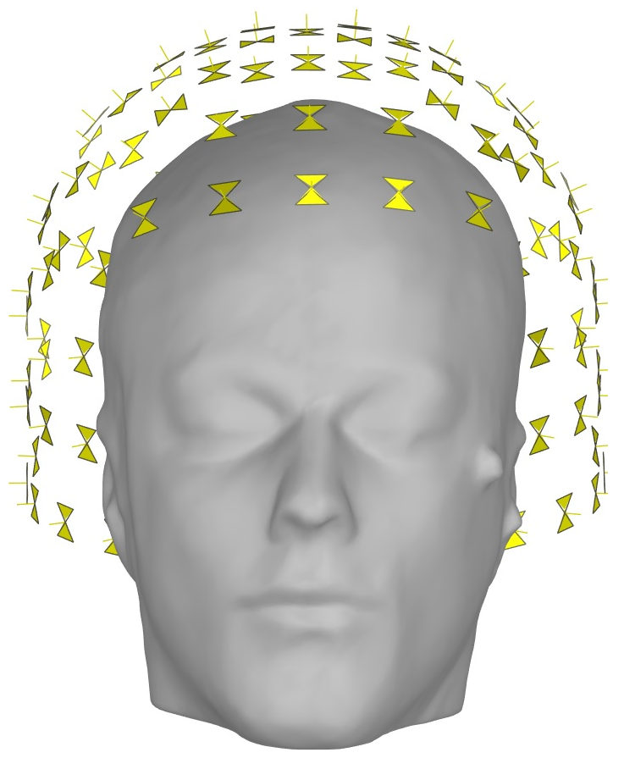
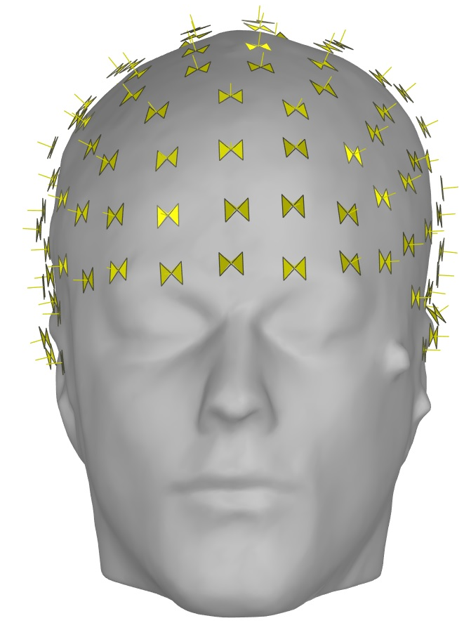
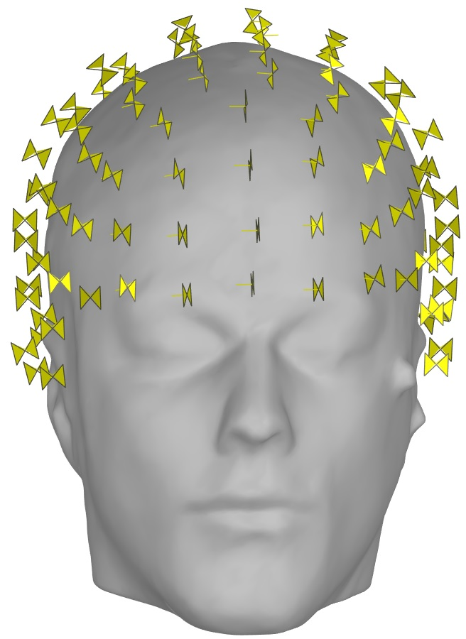
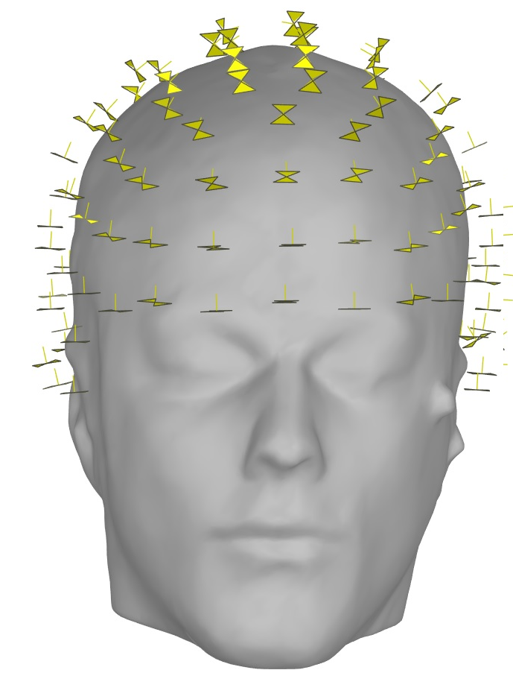
Sensors model
OPM
4 integration points
SQUIDs
Models from Brainstorm software
Magnetometer: 4 integration points
OPMn
OPMt1
OPMt2
MEG
OPMn
OPMt1
OPMt2
Notes:
OPMs do not need cryogenics and can thus be placed within millimetres from the scalp
into an array that adapts to the individual head size and shape, thereby reducing the distance from cortical
sources to the sensors
Here, we quantified the improvement in recording MEG on-scalp OPM
arrays
We simulated OPM arrays that measured either normal (nOPM; 102 sensors), tangential (tOPM; 204
sensors), or all components (aOPM; 306 sensors future) of the magnetic field.
For each model, the lead-field matrix L was computed using openmeeg
<numéro>

Slide 9
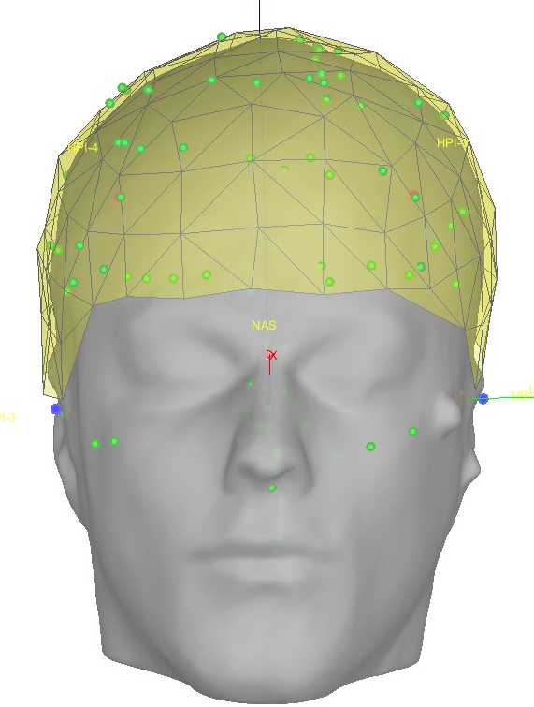
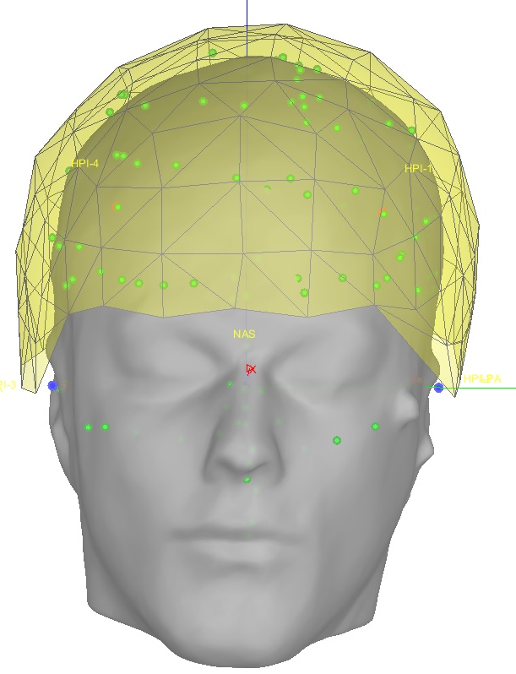
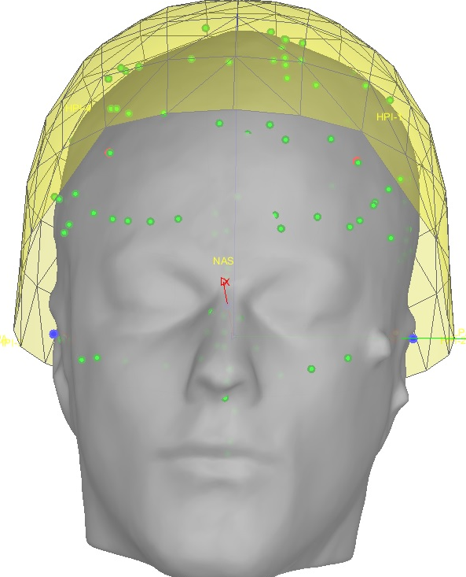
Sensors Helmet
OPMn
OPMt1
OPMt2
MEG
OPMn
OPMt1
OPMt2

Slide 10
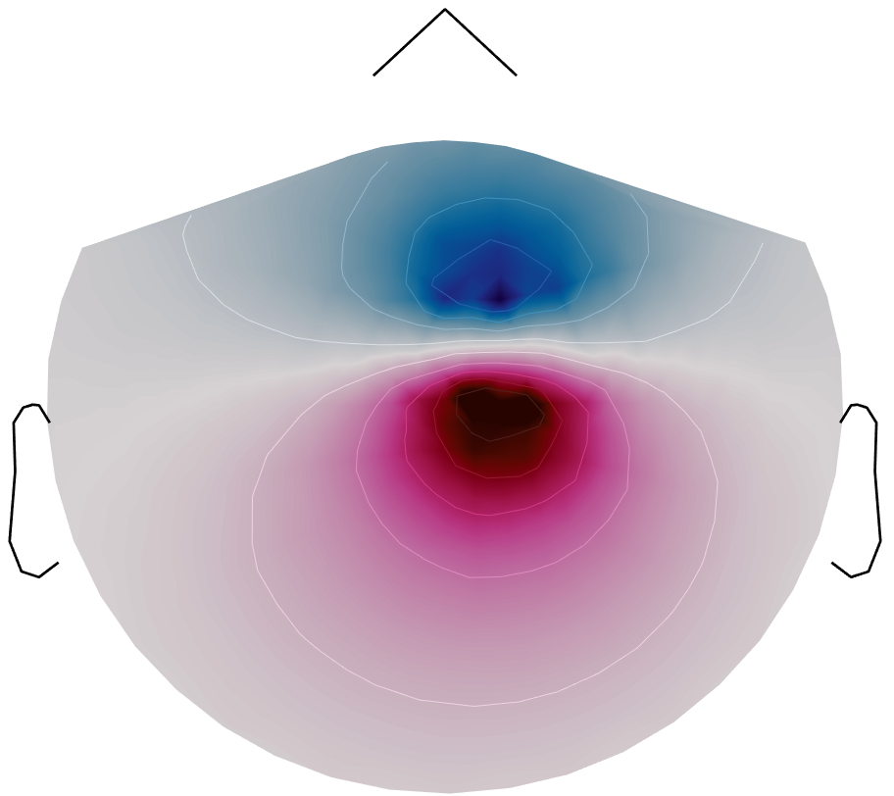
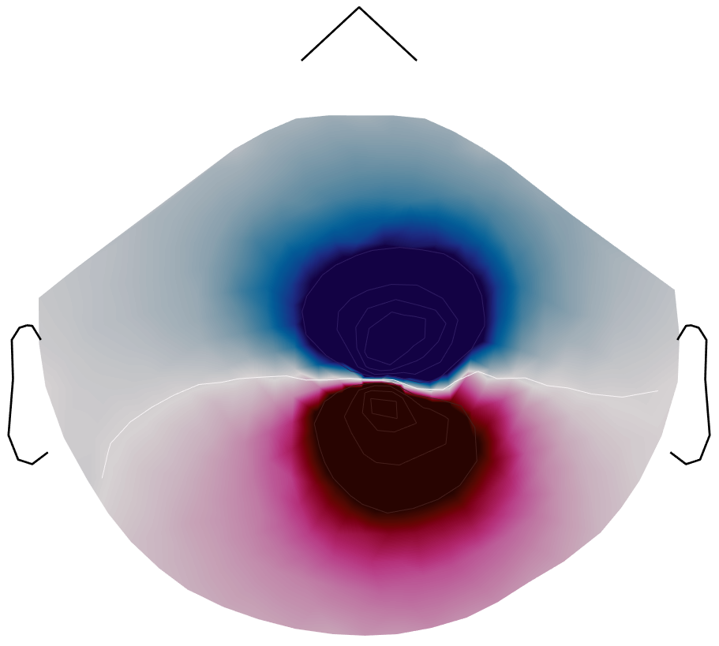
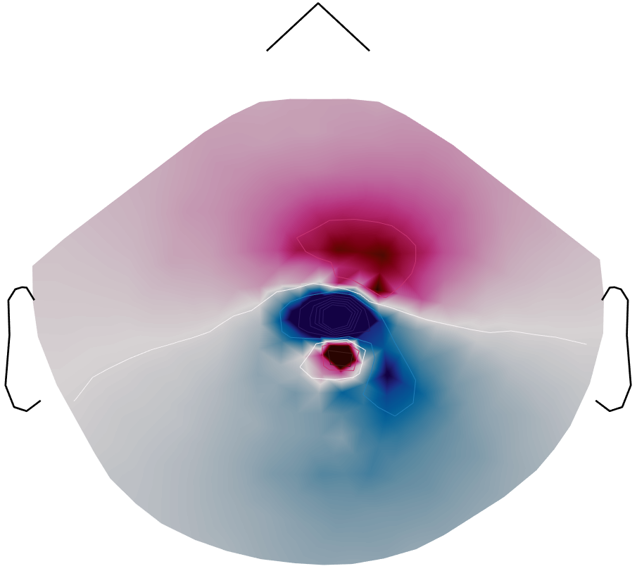
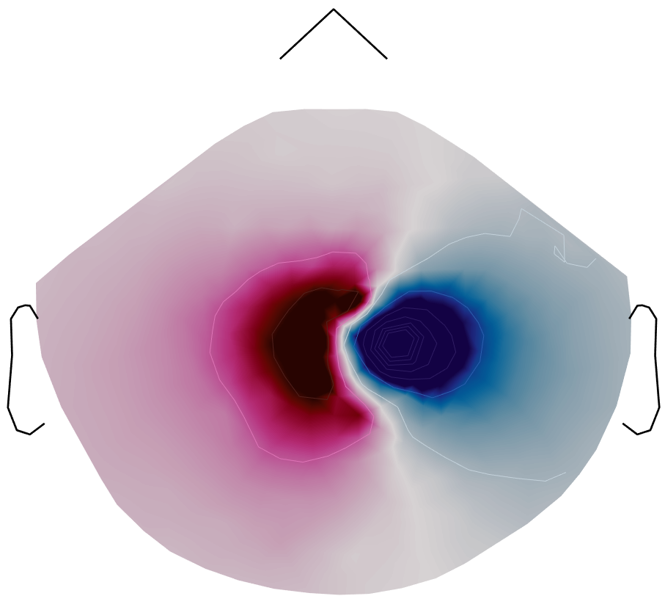
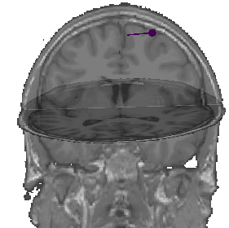
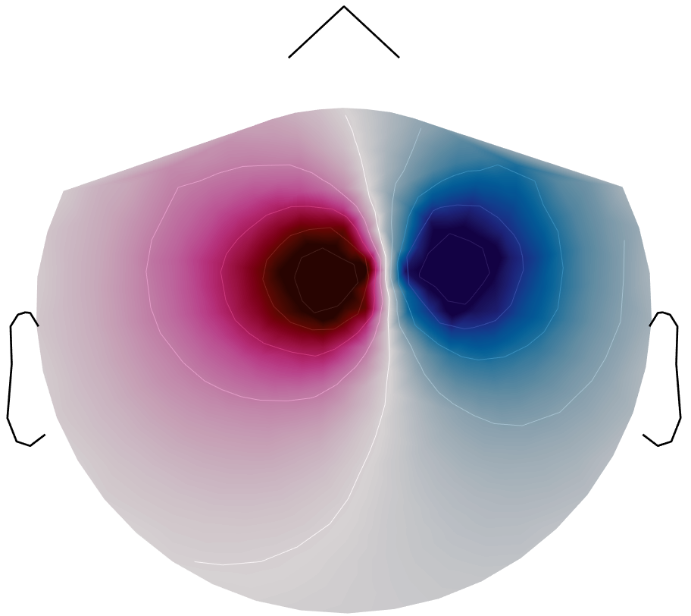
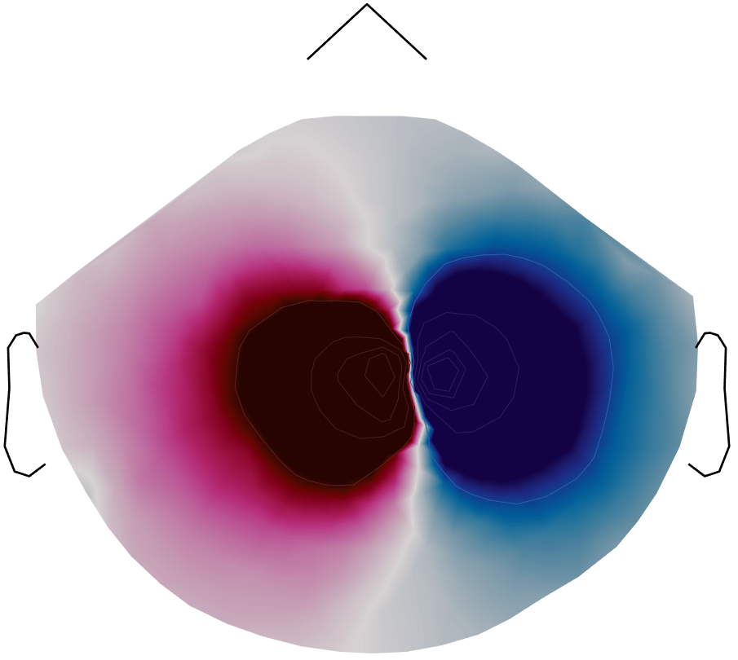
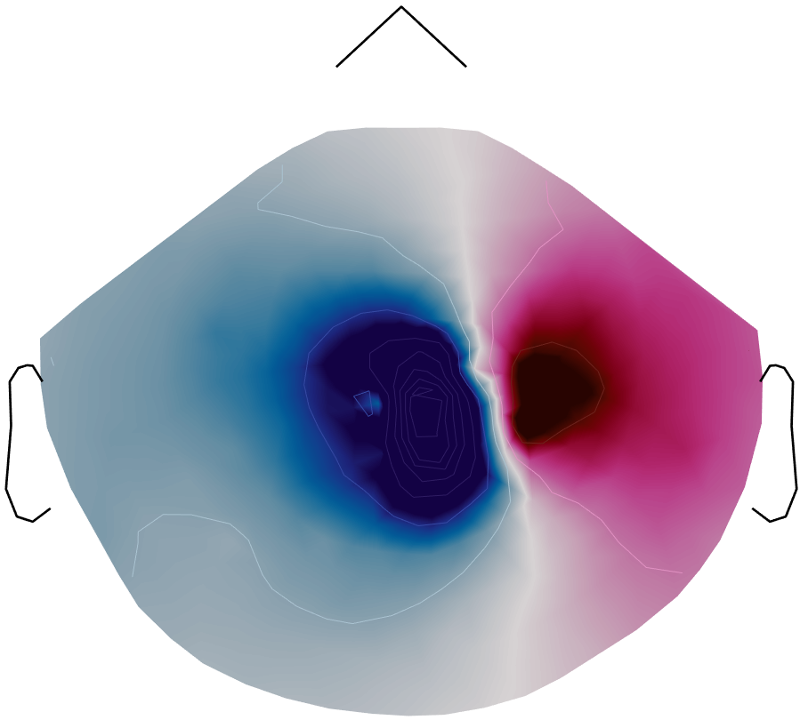
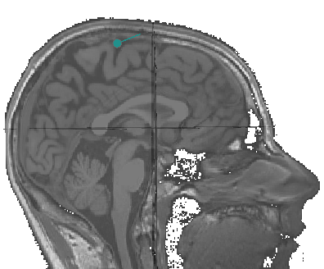
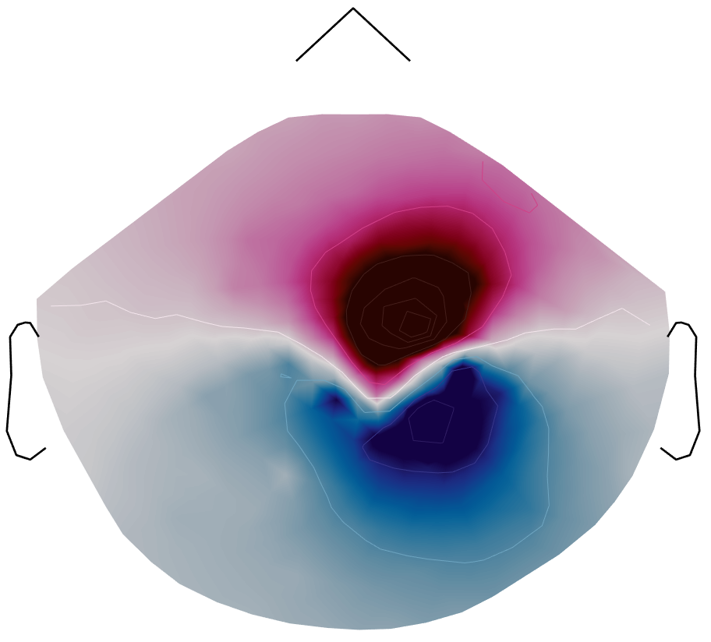
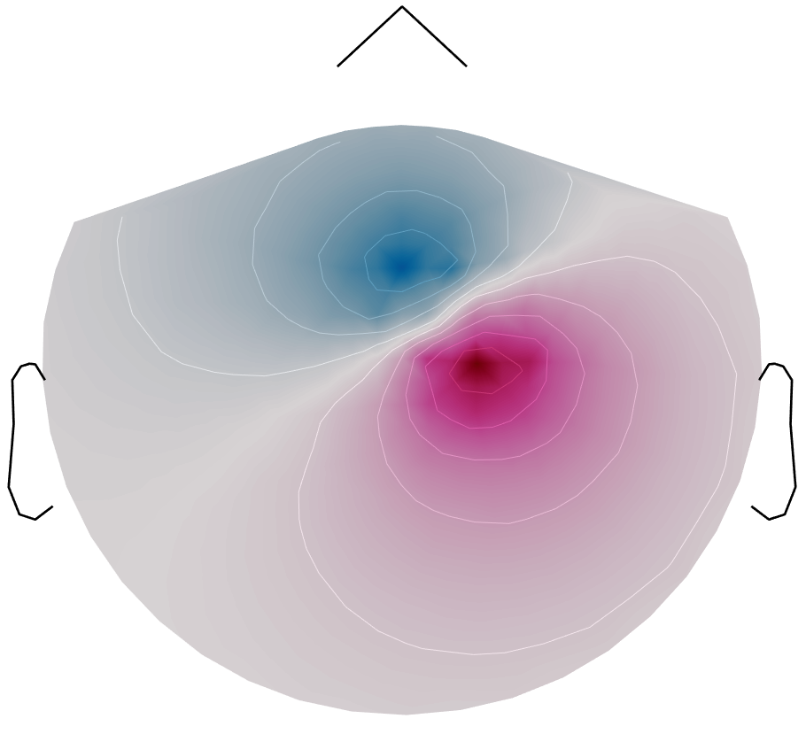
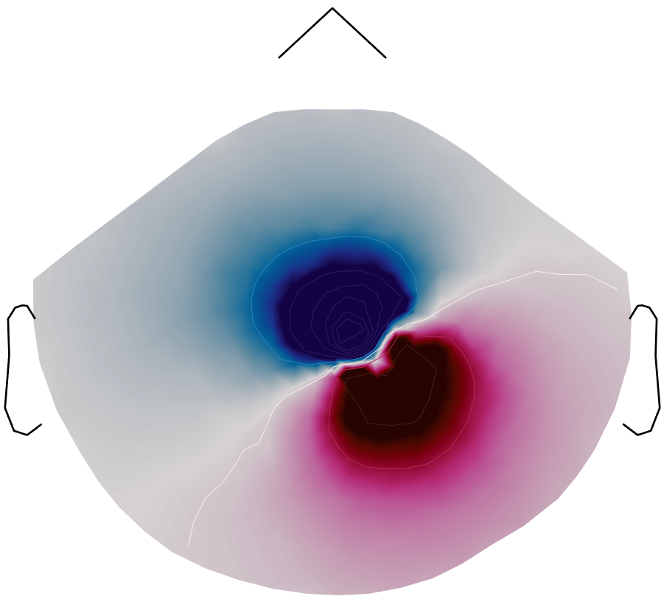
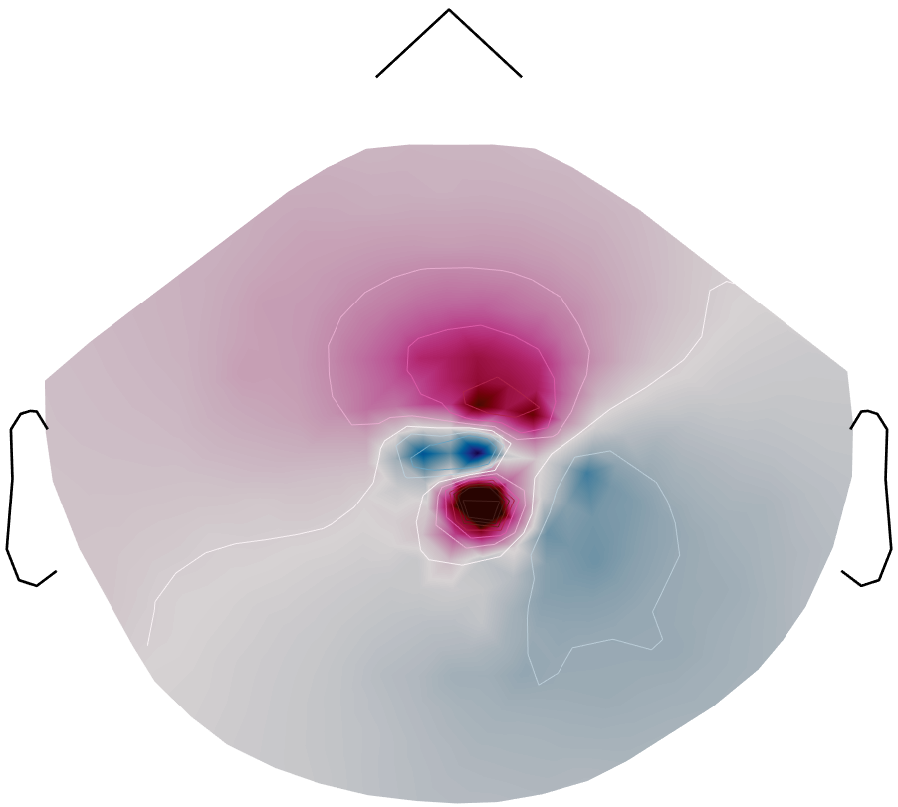
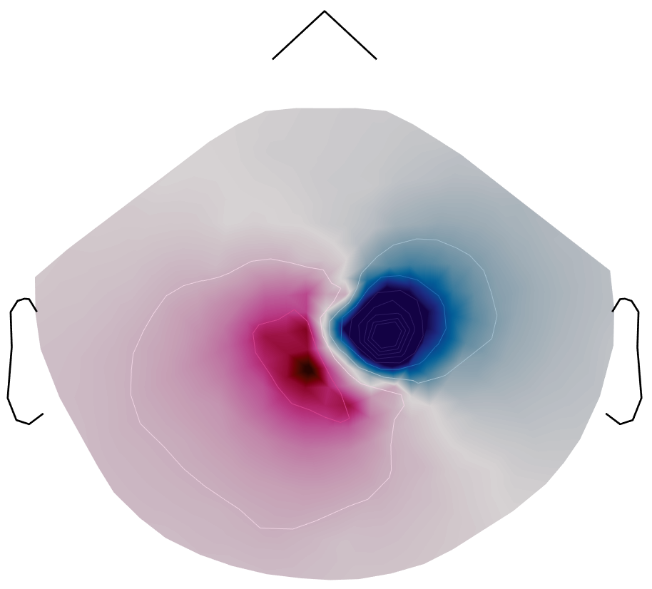
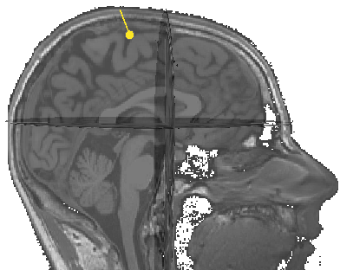
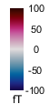
Topographical plots of simulated OPM MEG data
MEG
OPMn
OPMt1
OPMt2
Tangential dipole (coronal)
Tangential dipole (sagittal)
Near radial dipole

Slide 11
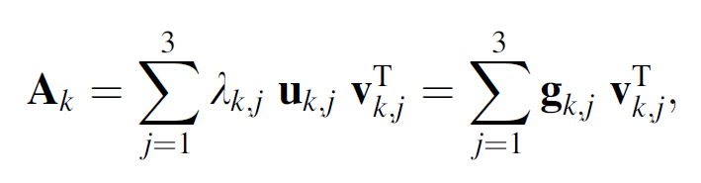
Evaluation Metrics
Sensitivity of MEG and OPM to Source Orientation
To examine the sensitivity of the MEG and OPM sensor arrays to sources of different orientations, we computed the SVD of the N x 3-dimensional dipolar gain matrix
at each location (Huang et al. 2007):
Topography power
Topography power = norm of the source topography squared
Total information
Measure derived from Shannon’s theory of communication
Quantifies the total information conveyed by the array per sample
Previously used to assess performance of various arrays (Kemppainen and Ilmoniemi, 1989; Nenonen et al., 2004; Schneiderman, 2014)
P : SNR
Notes:
To examine the sensitivity of the MEG and EEG sensor
arrays to sources of different orientations, we computed the
SVD of the N 9 3-dimensional dipolar gain matrix
Ak = [a3(k-1)?1, a3(k-1)?2, a3(k-1)?3] at each location indexed
by k = 1, …, M (Huang et al. 2007):
where uk,j and vk,j are the left and right singular vectors,
respectively, and lk,1, lk,2, and lk,3 are the singular values.
The N-dimensional vector gk,j = kk,j uk,j describes the
signal pattern in the MEG or opm sensor array generated
by a current dipole of unit amplitude in the orientation vk,j.
We denote the largest and smallest singular values, corresponding
to the dipole orientation to which the MEG
sensor array is the most and the least sensitive, as
kk,1 = kk,max and kk,3 = kk,min, respectively. In the spherically
symmetric volume conductor model kk,min = 0 for
MEG for all source locations, because the radial source
component does not generate any MEG signals.
We computed topography power of the arrays
We defined the topography power of ith source as the
l2-norm of the source topography squared, ∥ ti ∥
2.
Previously, the performance of various MEG
arrays has been assessed by computing the total information Itot
conveyed by the array (Kemppainen and Ilmoniemi, 1989; Nenonen
et al., 2004; Schneiderman, 2014). Itot quantifies all of the aspects of the
forward-model-based metrics, e.g., sensor distances to the sources,
sensor configuration, sensor type, SNR and dependencies of the sensor
lead fields, with a single number. We also used this metric to evaluate
the performance of the arrays.
<numéro>

Slide 12
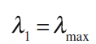
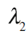
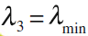
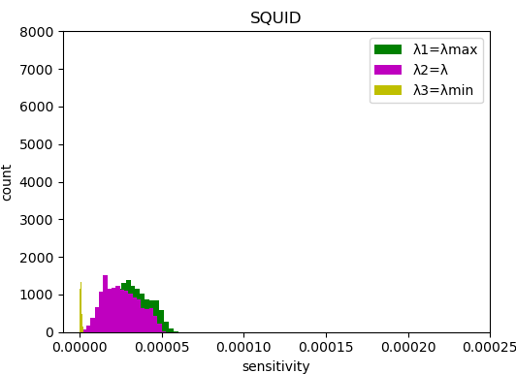
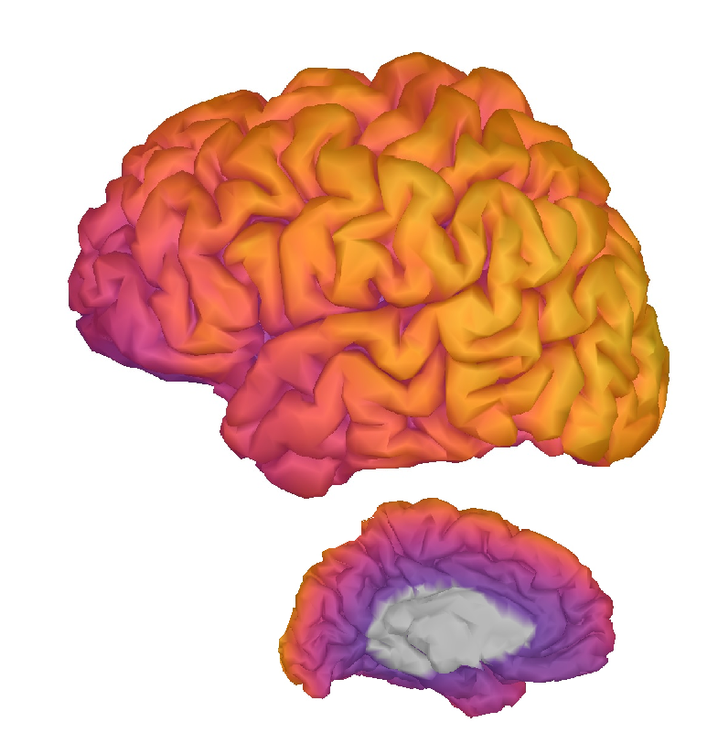
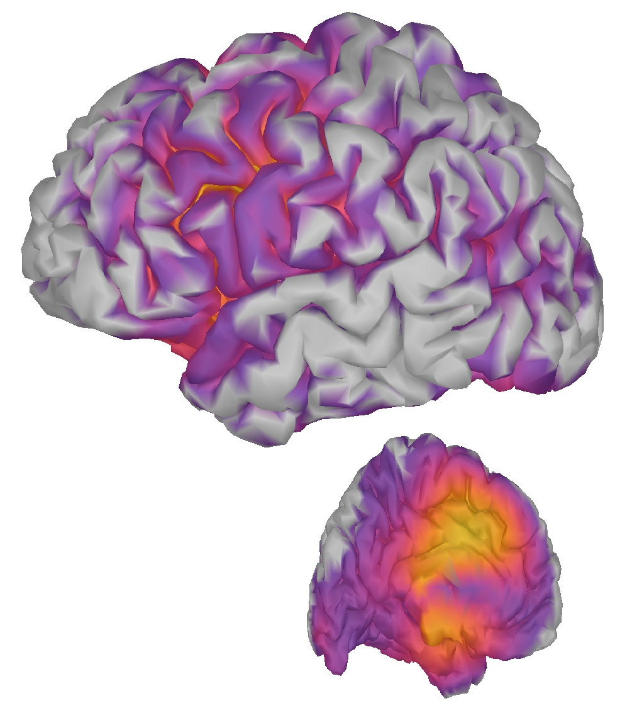
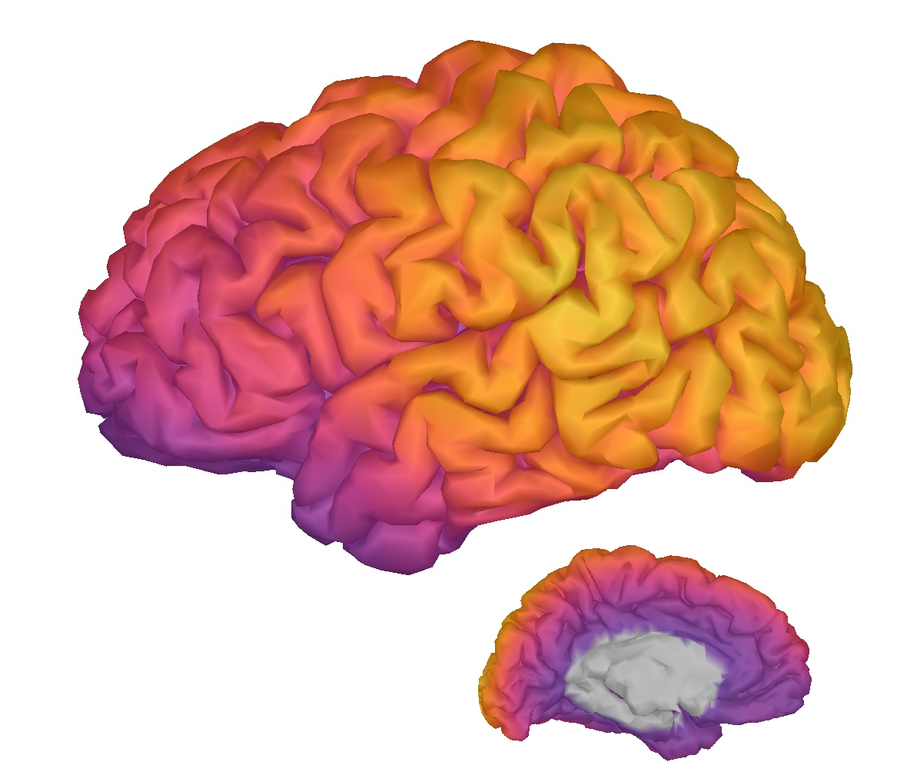
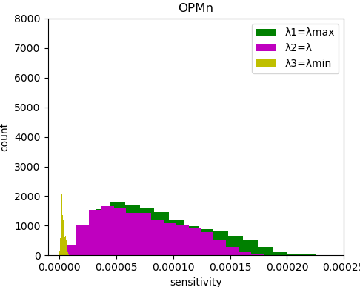
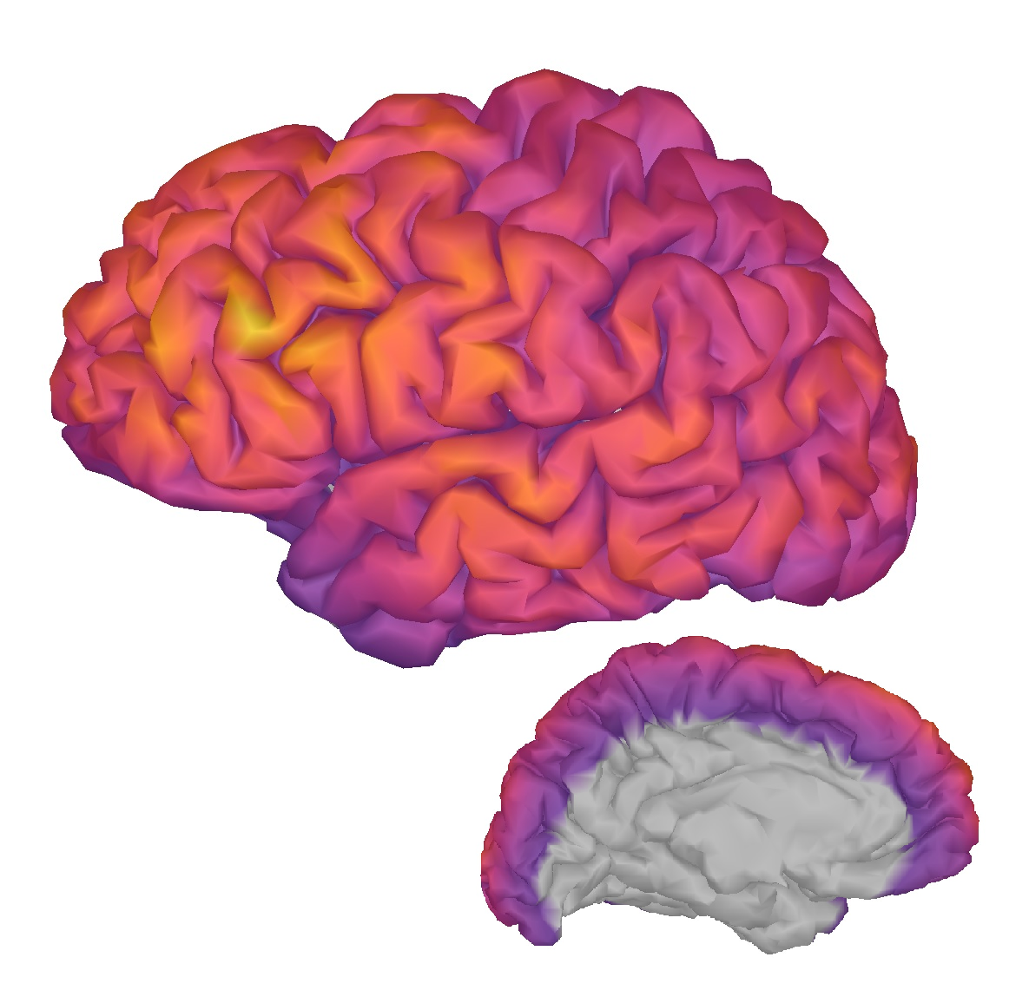
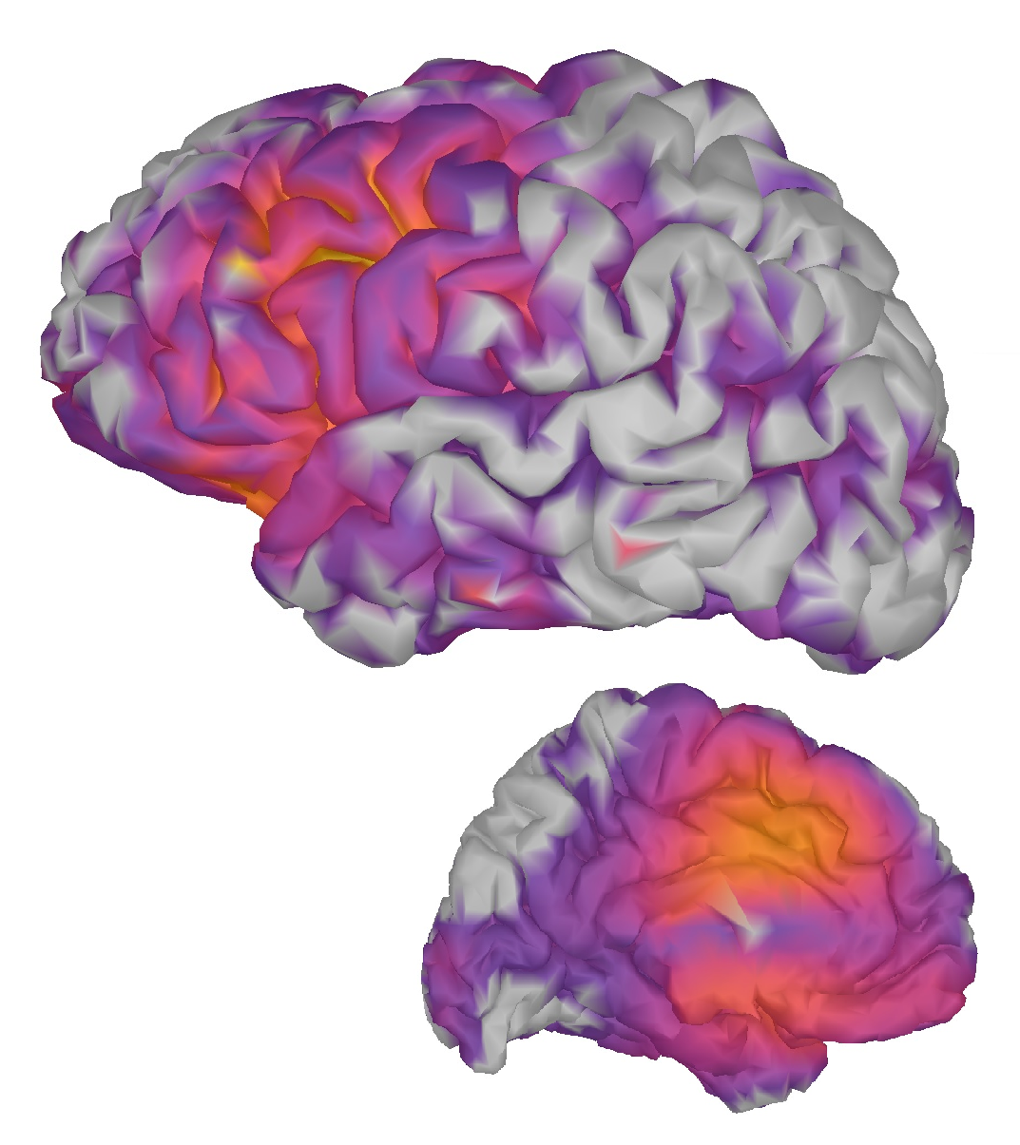
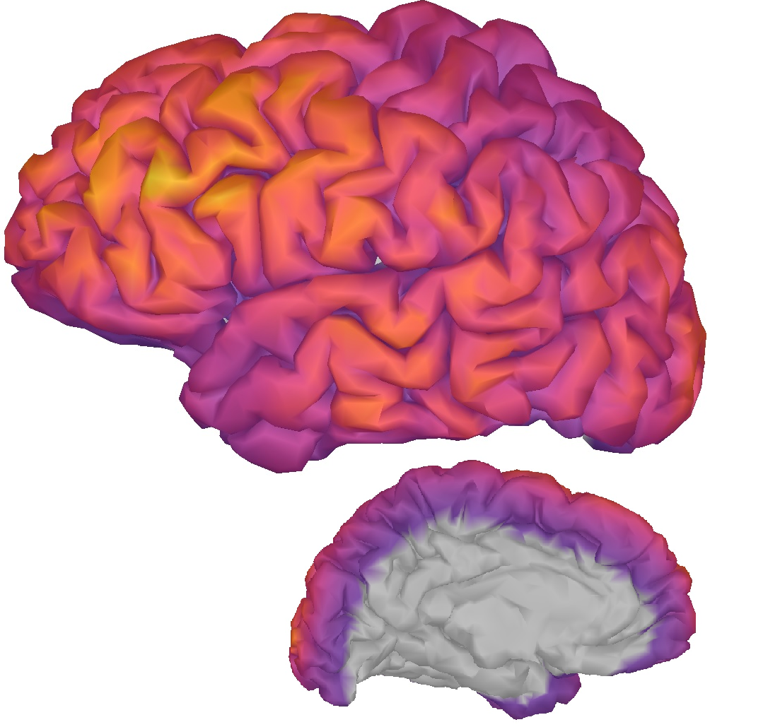
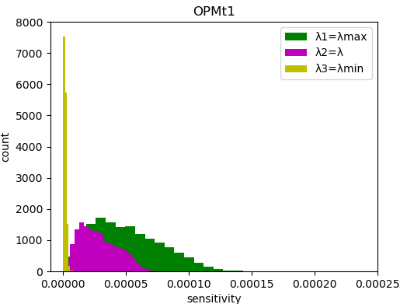
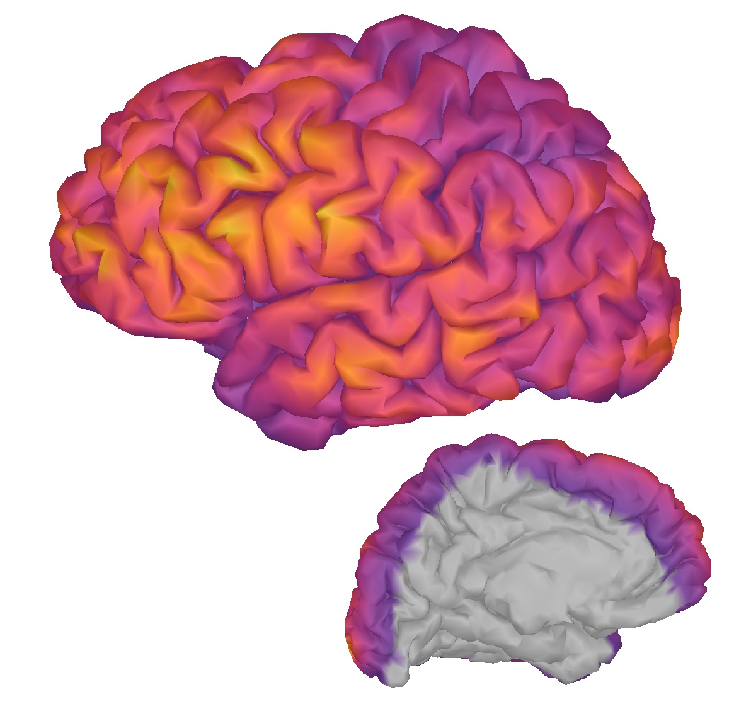
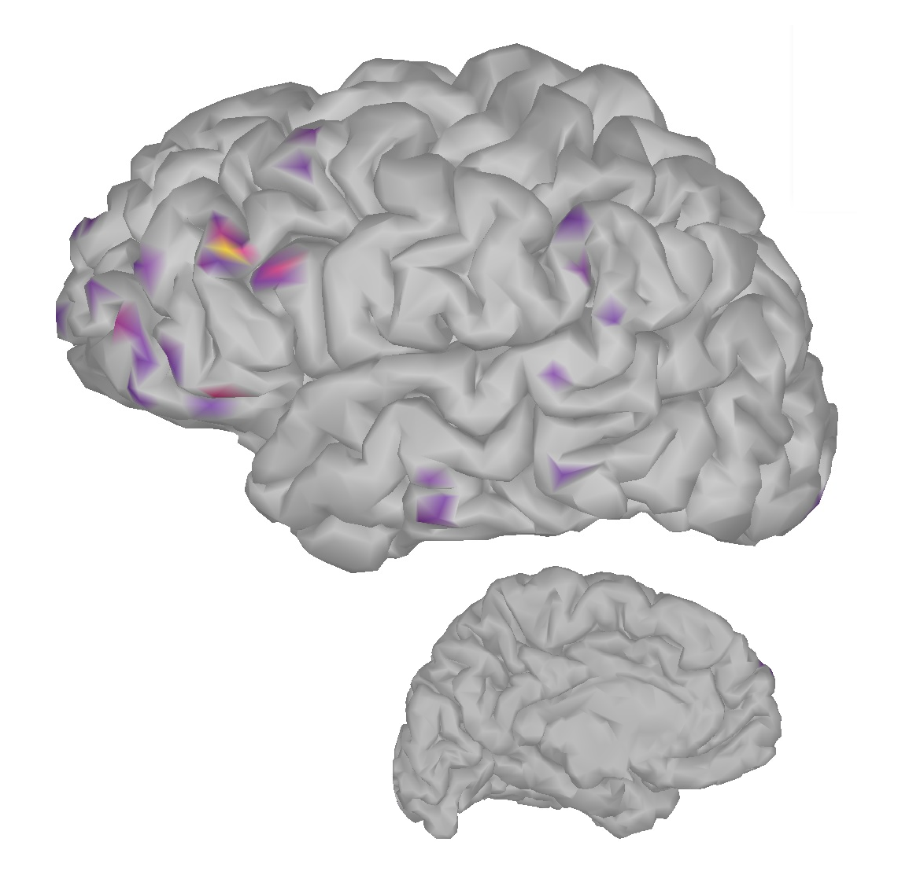





Distribution of the sensitivity to three orthogonal source
components
(tangential sources)
(tangential sources)
(radial sources)
MEG
OPMn
OPMt1
OPMt2
Notes:
The sensitivity of MEG and opm for three orthogonal
source orientations at each location on the cortex is shown
in here. The sensitivity was quantified by the three singular
values of the dipole gain matrix Ak. The singular
value corresponding to the highest sensitivity (kk,max)
showed a strong depth dependency for MEG and opm.
The histograms in illustrate how the sensitivity
of MEG and opm for one source orientation (corresponding to
kk,min) is typically much smaller than the other orientations.
To examine the dependency of MEG and opm signals on
the source orientation, we compared the forward solutions
for current dipoles with the orientation of the lowest and
the highest sensitivity across the cerebral cortex, i.e., dipole
orientations generating the smallest and the largest signals.
For most locations, there
was a ‘‘quiet’’ source orientation for both opm and MEG,.
(For EEG, the
sensitivity depended on the source orientation much less
than for MEG.)
<numéro>

Slide 13




Slide 14


Topography power
OPMn
OPMt1
OPMt2
MEG
Notes:
I would like to mention that this is for superficial sources (future deep sources)
Compared to the SQUID magnetometers, nOPM and tOPM yielded 7.5 and 5.3 times higher signal power
<numéro>

Slide 15
















Topography power
OPMn
OPMt1
OPMt2
OPMa
MEG

Slide 16


Topography power
Notes:
Compared to the SQUID magnetometers, nOPM and tOPM yielded 7.5 and 5.3 times higher signal power
nOPM had the
strongest overall topography power
<numéro>

Slide 17


Topography power - Normaliztion
Notes:
Compared to the SQUID magnetometers, nOPM and tOPM yielded 7.5 and 5.3 times higher signal power
nOPM had the
strongest overall topography power
<numéro>

Slide 18
Total information
Itot_opmn = 560.2602
Itot_opmt1 = 439.31
Itot_opmt2 = 433.88
Itot_squid = 246.94
Notes:
The information capacities of the OPM arrays were clearly higher than
that of the SQUID array.
Both of the OPM arrays (nOPM
and tOPM) provide more information than SQUID. The
total information capacity per sensor is highest in nOPM. According to our results, the information capacities of the OPM arrays
are clearly higher than that of the state-of-the-art SQUID array
<numéro>

Slide 19
Next step
Evaluation using additional metrics, (Primary and volume currents contributions, Effective Field of View (eFOV)
Mutual information, …)
Importing the 9 years old anatomy, and redo all simulations for this model: we can expect in this case, that the added value of OPM compared to SQUID will be even greater than in the adult case.
Combining the 3 axis measurement of OPM (eg, using SVD )
Perform real measurements in Brussels and process the data
Notes:
The aim of this study was to assess the possible benefits of on-scalp
MEG arrays that can be constructed using novel magnetic field sensors,
e.g., optically-pumped magnetometers (OPMs). The
assessment was done by comparing the performance of state-of-the-art
SQUID sensor arrays to our on-scalp arrays, As on-scalp arrays, we defined three OPM
arrays that measured normal (nOPM; 102 sensors), tangential
(tOPM; 204 sensors) or normal and tangential (aOPM; 306 sensors)
components of the magnetic field with respect to the local surface of the
scalp. In the comparison, we used metrics derived from forward
that quantified signal power, information capacity, sensitivity, (future metris based on inverse model like psf)
<numéro>

Slide 20
Next step
Evaluation using additional metrics, (Primary and volume currents contributions, Effective Field of View (eFOV)
Mutual information, …)
Importing the 9 years old anatomy, and redo all simulations for this model: we can expect in this case, that the added value of OPM compared to SQUID will be even greater than in the adult case.
Combining the 3 axis measurement of OPM (eg, using SVD )
Perform real measurements in Brussels and process the data
Notes:
The aim of this study was to assess the possible benefits of on-scalp
MEG arrays that can be constructed using novel magnetic field sensors,
e.g., optically-pumped magnetometers (OPMs). The
assessment was done by comparing the performance of state-of-the-art
SQUID sensor arrays to our on-scalp arrays, As on-scalp arrays, we defined three OPM
arrays that measured normal (nOPM; 102 sensors), tangential
(tOPM; 204 sensors) or normal and tangential (aOPM; 306 sensors)
components of the magnetic field with respect to the local surface of the
scalp. In the comparison, we used metrics derived from forward
that quantified signal power, information capacity, sensitivity, (future metris based on inverse model like psf)
<numéro>

Slide 21

Importing the 9 years old anatomy
Brainstorm is interfaced with the DICOM converter from SPM
Once you have your MRI volume in the Brainstorm database,
you can run the segmentation with CAT12

Slide 22




MEG sensors model
2 cm

Slide 23


Constructing the OPM sensors model

Slide 24


Constructing the OPM sensors model

Slide 25





Constructing the OPM sensors model
OPMn
OPMt1
OPM2
OPMall

Slide 26



Distribution of the sensitivity to three orthogonal source
components

Slide 27



Distribution of the sensitivity to three orthogonal source
components

Slide 28
Next step
Evaluation using additional metrics, (Primary and volume currents contributions, Effective Field of View (eFOV)
Mutual information, …)
Importing the 9 years old anatomy, and redo all simulations for this model: we can expect in this case, that the added value of OPM compared to SQUID will be even greater than in the adult case.
Combining the 3 axis measurement of OPM (eg, using SVD )
Perform real measurements in Brussels and process the data
Notes:
The aim of this study was to assess the possible benefits of on-scalp
MEG arrays that can be constructed using novel magnetic field sensors,
e.g., optically-pumped magnetometers (OPMs). The
assessment was done by comparing the performance of state-of-the-art
SQUID sensor arrays to our on-scalp arrays, As on-scalp arrays, we defined three OPM
arrays that measured normal (nOPM; 102 sensors), tangential
(tOPM; 204 sensors) or normal and tangential (aOPM; 306 sensors)
components of the magnetic field with respect to the local surface of the
scalp. In the comparison, we used metrics derived from forward
that quantified signal power, information capacity, sensitivity, (future metris based on inverse model like psf)
<numéro>

Slide 29



Primary and volume current topographies
Geselowitz 1970
+
=

Slide 30
Alexandre :
yes you can do this with openmeeg
https://openmeeg.github.io/tutorial.html#om-gain
you would need to zero either of the matrices Source2MEGMat or Head2MEGMat
see the note
you read the matrix in matlab, put only zeros and save it back using om_xxx functions in brainstorm
Alex

Slide 31
















Tangential dipole (coronal)
MEG (2cm)
OPMn
OPMt1
OPMt2
MEG
Primary current
Volume current
Total

Slide 32
















Tangential dipole (sagittal)
MEG
MEG
OPMn
OPMt1
OPMt2
Primary current
Volume current
Total

Slide 33
















Near radial dipole
MEG
MEG
OPMn
OPMt1
OPMt2
Primary current
Volume current
Total

Slide 34





Slide 35
Near radial dipole
MEG
MEG
OPMn
OPMt1
OPMt2
Primary current
Volume current
Total

Slide 36
TPx:
nOPM: 1,004
TOPM1: 0,27
TOPM2: 0,47
MEG (2cm): 0,97
MEG: 0,92
TPy:
nOPM: 1,0056
TOPM1: 0,23
TOPM2: 0,31
MEG (2cm): 0,91
MEG: 0,89
TPz:
NOPM: 0,83
TOPM1: 0,76
TOPM2: 0,23
MEG (2cm): 0,79
MEG: 0,75
PVx:
nOPM: 3,72
TOPM1: 1,10
TOPM2: 0,91
MEG (2cm): 2,94
MEG: 1,93
PVy:
NOPM: 3,73
TOPM1: 1,04
TOPM2: 0,94
MEG (2cm): 2,80
MEG: 2,15
PVz:
NOPM: 3,90
TOPM1: 0,67
TOPM2: 1,11
MEG (2cm): 3,15
MEG: 2,97

Slide 37
TP:
nOPM: 0,98
TOPM1: 0,46
TOPM2: 0,38
MEG: 0,87
PV:
nOPM: 4,08
TOPM1: 0,93
TOPM2: 0,97
MEG: 2,46

